Slide 1
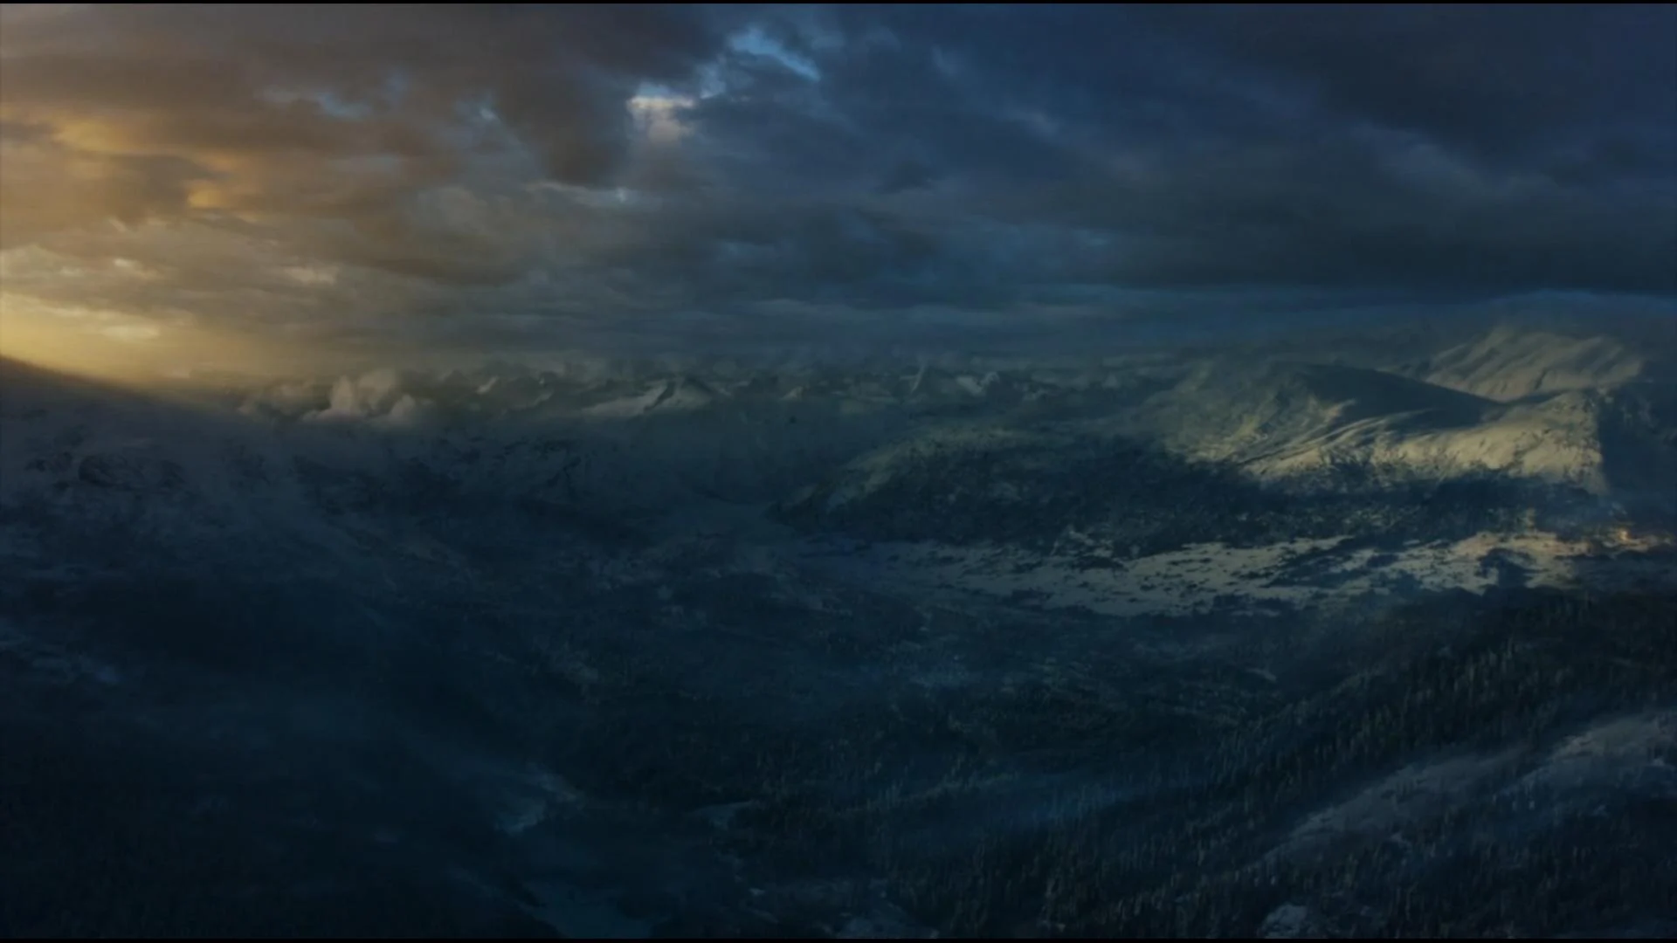

IDS 564 A SONG OF ICE AND FIRE – A SOCIAL NETWORK ANALYSIS
Karthick Sharan

Slide 2
1. INTRODUCTION 2. DATASET AND BACKGROUND 3. RESEARCH QUESTION 4. INITIAL DATA EXPLORATION 5. COMMUNITY DETECTION 6. CENTRALITY MEASURES 7. DETERMINING THE CHARACTER ARCH 8. ROLE OF WEAK AND STRONG TIES 9. FRIENDS AND FOES – STRUCTURAL BALANCE 10. LONGEST PLOT – CLIQUE ANALYSIS 11. FUTURE RESEARCH 12. CONCLUSION
CONTENT

Slide 3
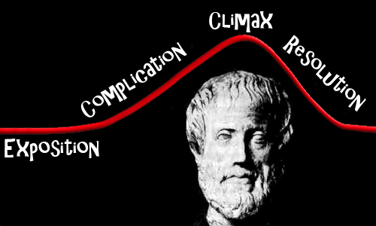
1. INTRODUCTION
The structure of performed stories shapes the meaning produced in the audience - Aristotle
A storyline is called a “plot” because you can create a visual plot of the rising and falling action
So, the combination of criticism & data visualization goes back 150 years!

Slide 4
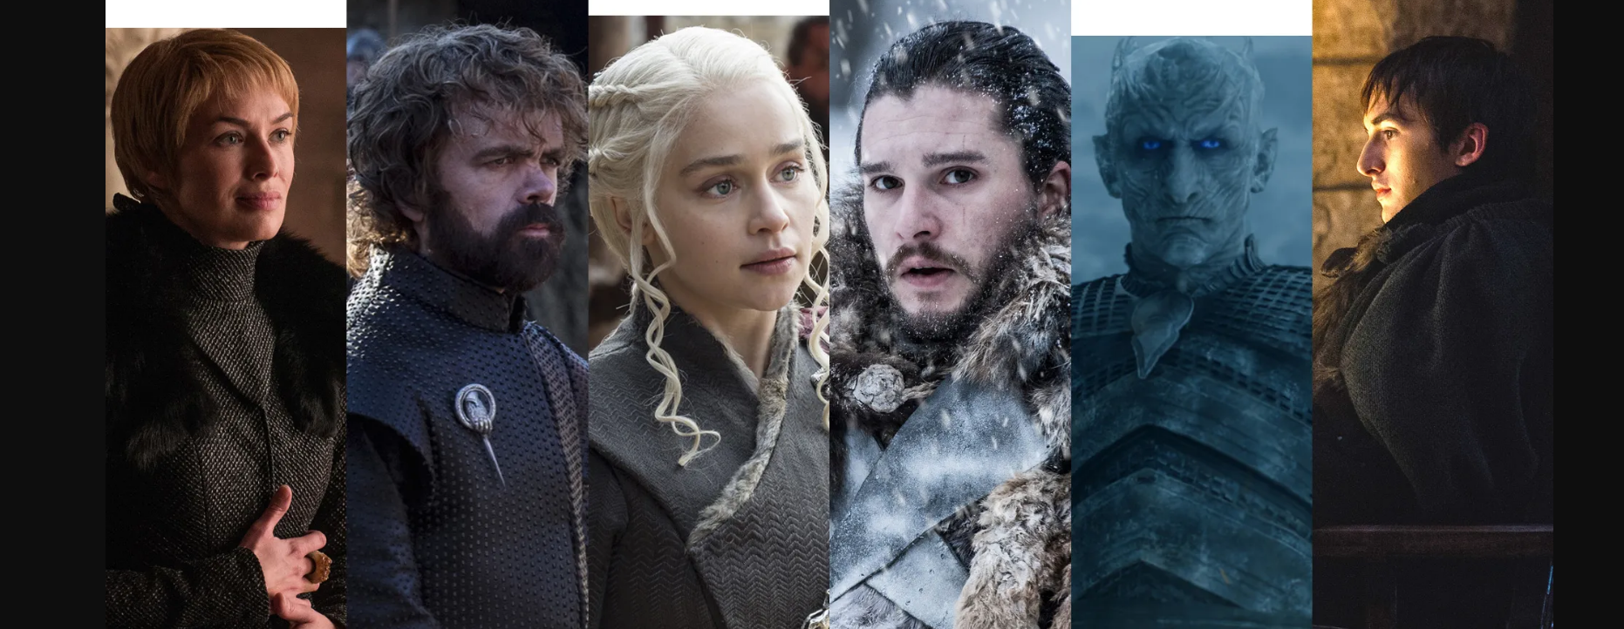
1. INTRODUCTION AND MOTIVATION
FRACTAL PROTAGONIST
MAIN CHARACTER: Appears frequently in the work
A HERO: Has a laudable personal trait
A PROTAGONIST: Goes through struggles and hardship, is compelled to act and their choices determine the

Slide 5
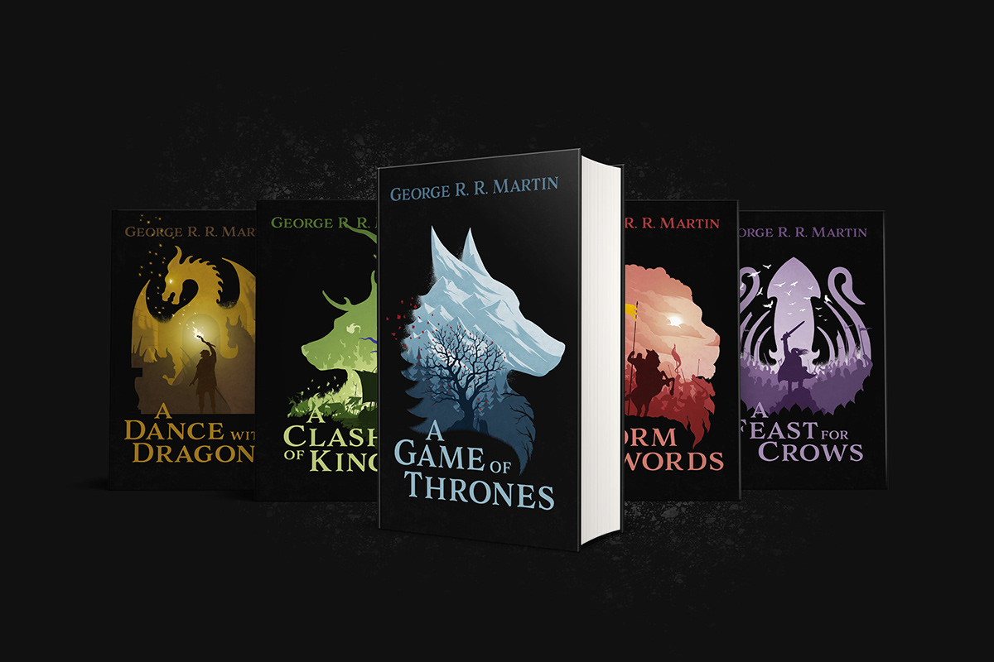
2. Dataset and Background
5 Books of The Song of Ice and Fire Series
796 characters (Nodes) and 2823 connections (Edges)
Individual nodes and edges are also available for each books for individual character development analysis

Slide 6
3. Research Questions
Community detection to identify the different kingdoms and how they interact throughout the series
Character arc representation taken by the main characters
Fractal protagonists across different scaling
Role of weak ties in the development of the plot
Friends and Foes – Triadic Closure
The longest plot/scene in each book – Cliques

Slide 7
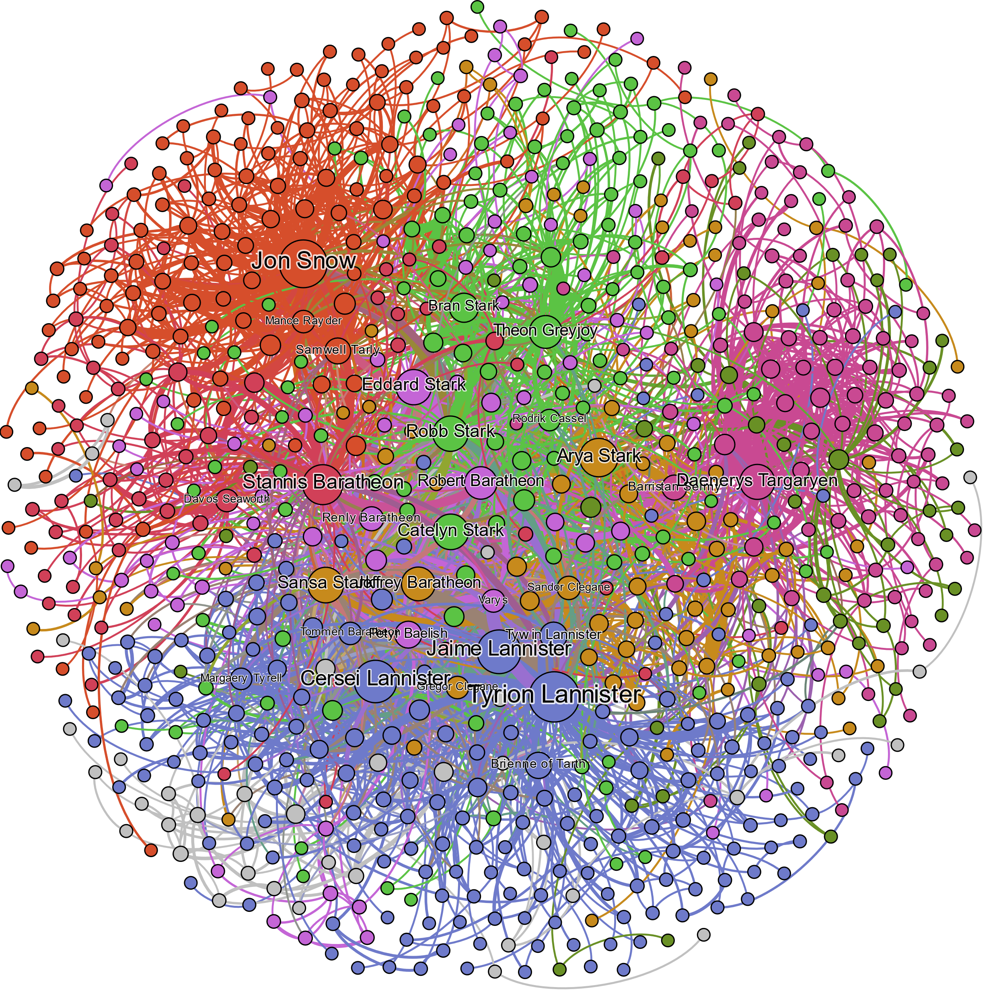
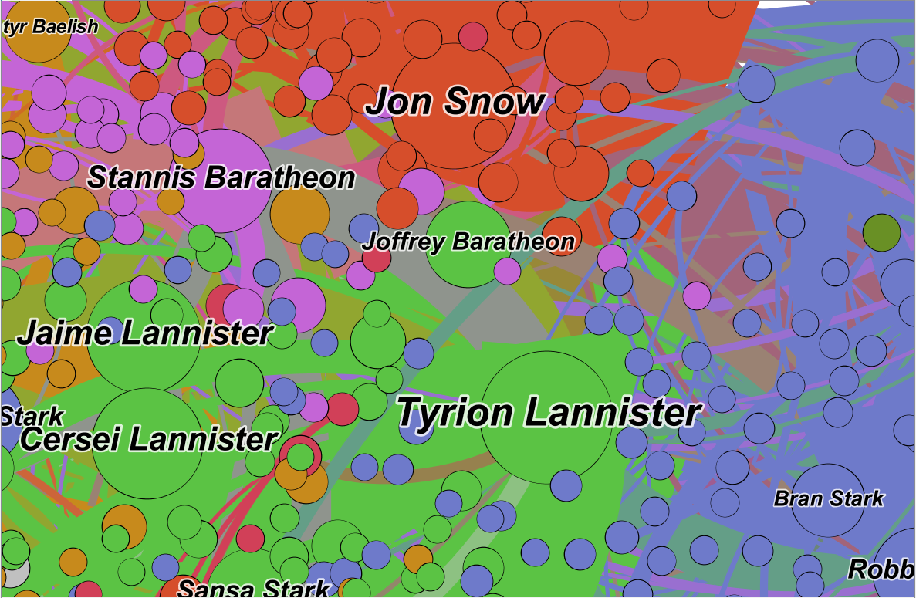
4. Initial Graph Visualization
A Detailed View
Network Statistics
Metric | Average Degree | Average Weighted Degree | Average Path Length | Network Diameter | Graph Density | Average Clustering Co-efficient
Value | 7.093 | 81.982 | 3.416 | 9.2 | 0.01 | 0.653

Slide 8
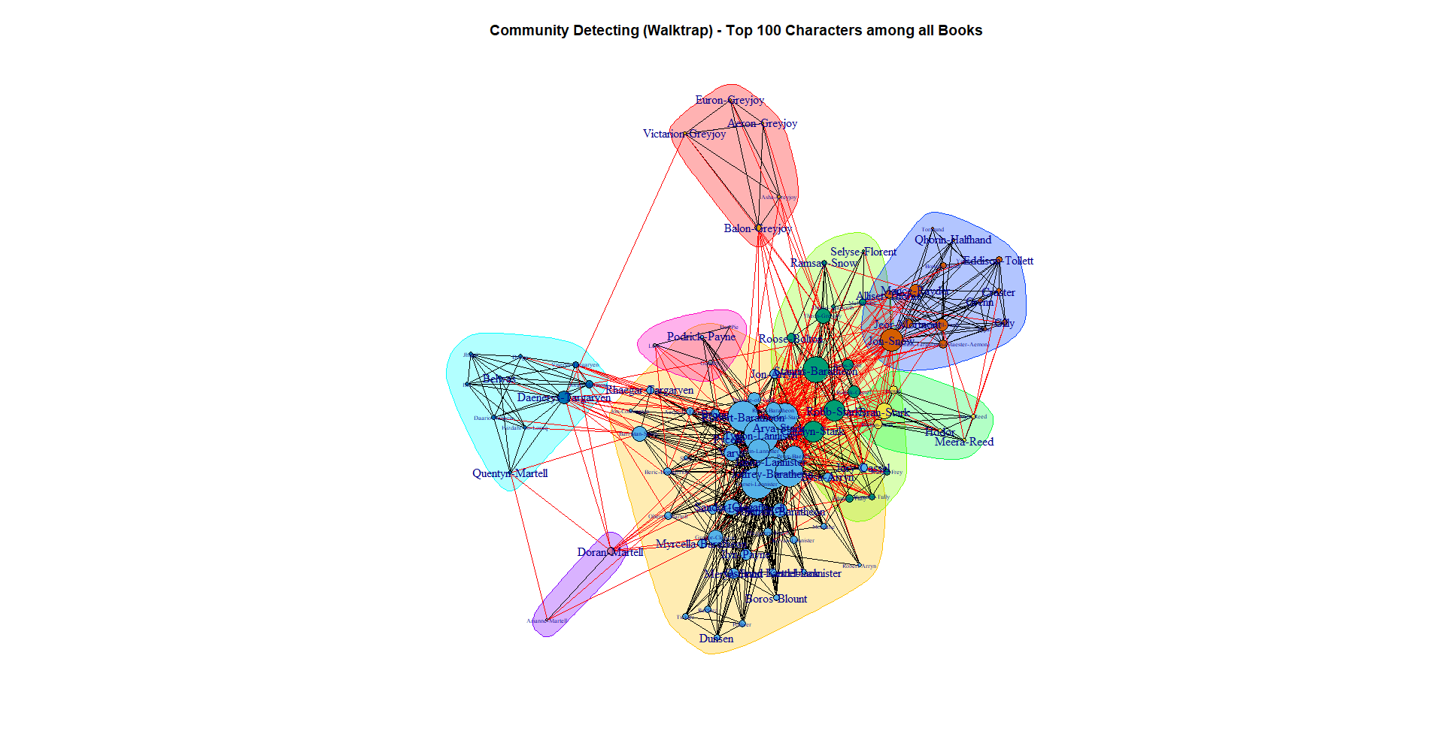
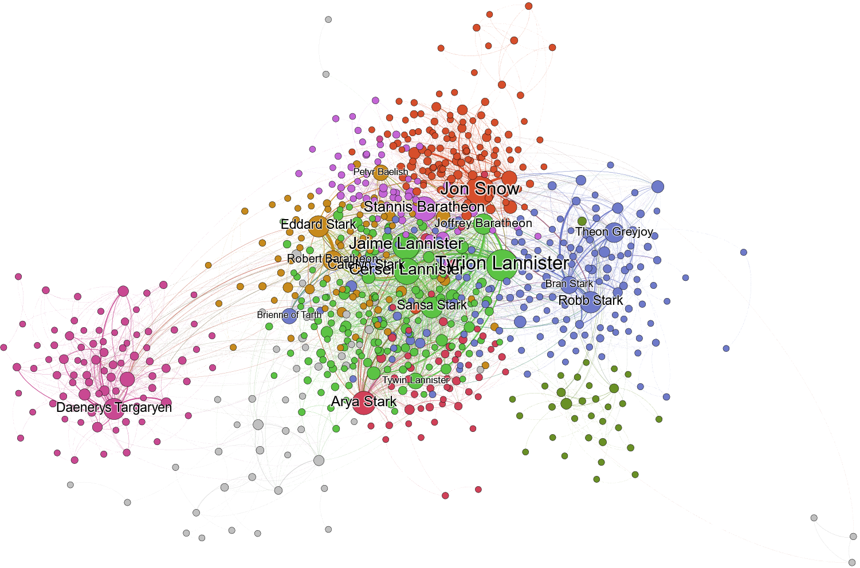
5. Community Detection
Top communities:
King’s Landing (Green): Tyrion, Jamie, Cercei, Sansa, Joffrey
The wall (Red): Jon Snow, Samwell
The North (Blue): Robb, Bran, Theon
Essos (Pink): Daenerys, Jorah

Slide 9
6. Centrality measures
Characters | Degree | Weighted Degree | Closeness centrality | Betweenness centrality | Page ranks | Eigen centrality
Jon Snow | 114 | 2757 | 0.445 | 0.192 | 0.019 | 0.652
Tyrion Lannister | 122 | 2873 | 0.476 | 0.162 | 0.018 | 1.000
Jaime Lannister | 101 | 1569 | 0.452 | 0.101 | 0.015 | 0.882
Stannis Baratheon | 89 | 1375 | 0.445 | 0.110 | 0.014 | 0.743
Arya Stark | 84 | 1460 | 0.431 | 0.087 | 0.013 | 0.690
Cersei Lannister | 97 | 2232 | 0.455 | 0.089 | 0.013 | 0.914
Daenerys | 73 | 1608 | 0.383 | 0.118 | 0.013 | 0.302
Theon Greyjoy | 66 | 782 | 0.423 | 0.111 | 0.012 | 0.439
Eddard Stark | 74 | 1649 | 0.456 | 0.079 | 0.011 | 0.759
Catelyn Stark | 75 | 1230 | 0.433 | 0.055 | 0.011 | 0.697
Robb Stark | 74 | 1424 | 0.444 | 0.066 | 0.011 | 0.696
Sansa Stark | 75 | 1547 | 0.433 | 0.049 | 0.010 | 0.795
Joffrey Baratheon | 69 | 1762 | 0.434 | 0.032 | 0.009 | 0.830
Robert Baratheon | 65 | 1488 | 0.459 | 0.078 | 0.009 | 0.771
Bran Stark | 54 | 1508 | 0.419 | 0.045 | 0.008 | 0.501

Slide 10
6. Centrality Measure – Fractal Protagonist Inference
The number of nodes that are directly connected to a node via an edge determines its degree of centrality
This is simply a tally of how many individuals the character has interacted with at least once
Betweenness centrality identifies nodes in the network that are strategically positioned, implying that information will frequently pass through them
A person in such a position of intermediation gains power and influence
The sum of the weights of the edges incident with the node is the weighted degree of centrality
This is the total number of times the character has interacted with other characters.
The importance of the neighbor is divided among their neighbors in proportion to the number of encounters with that neighbor
PageRank, on the surface, measures how well you utilize your network contacts.
PageRank centrality conveys narrative tension effectively in our scenario. When two essential characters interact, major developments occur
You earn full credit for knowing someone essential in this metric, even if you don't know them very well
This determines how powerful (in principle) your network is, regardless of whether you are utilizing it to its maximum potential

Slide 11
6. Centrality Measure - Fractal Protagonist Inference
Inference:
PageRank is the best measure for narrative dominance: important things happen when influential people interact
If the book was to end here, Cersei, Tyrion and Jon has the biggest momentum
Jon has essentially held steady throughout the saga
Tyrion, Arya and Cersei have trended downwards
Jaime, Stannis and Daenerys have trended upwards
Depending on how Daenerys wields her might and influence (and dragons) when she arrives in Westeros, she could take second place, or even the top spot

Slide 12
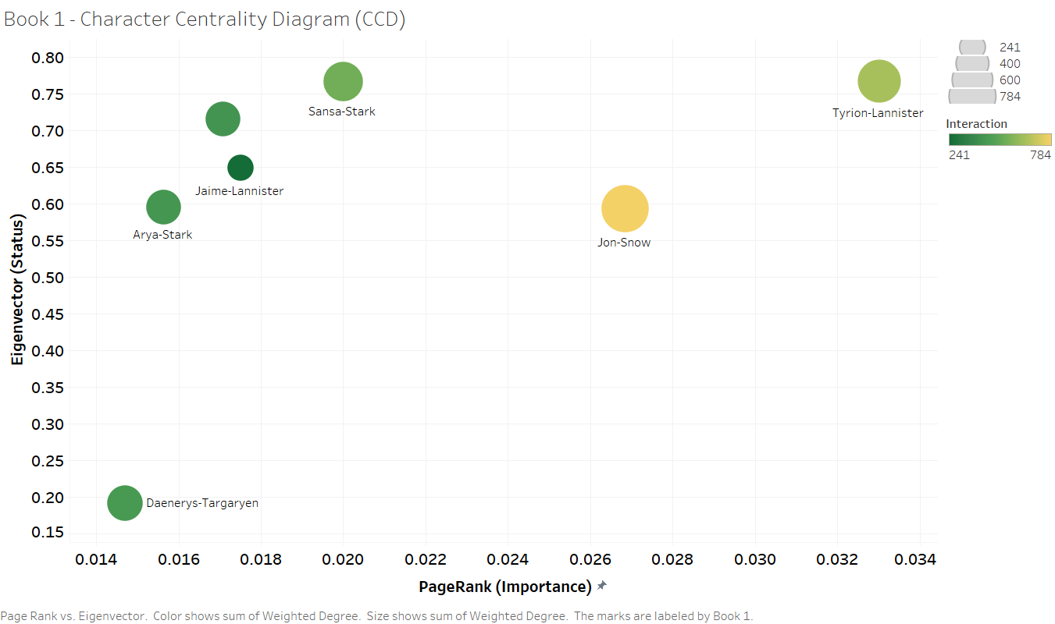
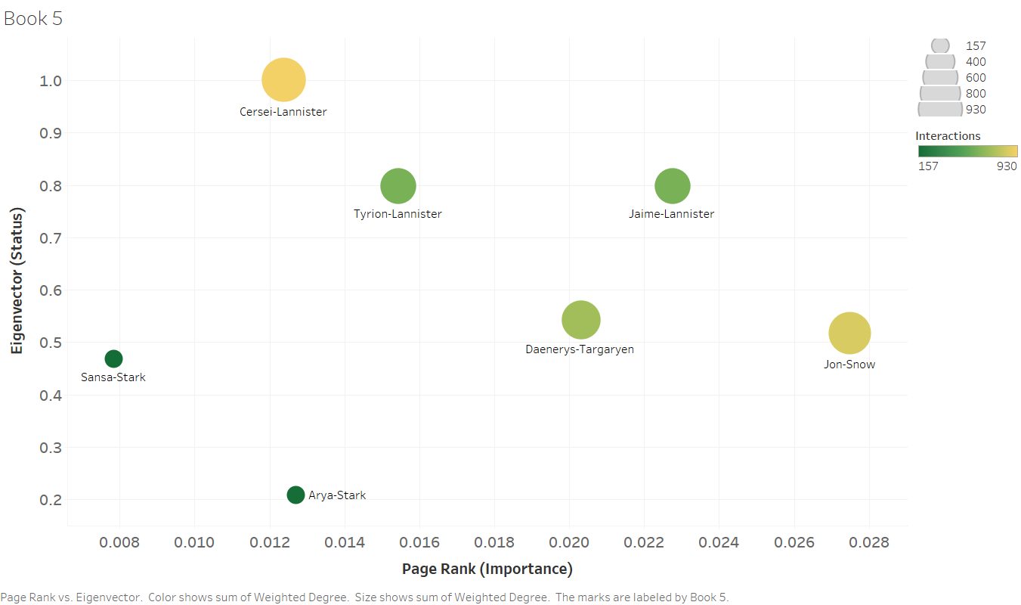
7. Determining the character arch – Character Centrality Diagram (CDC)
PageRank Centrality, a measure of the character's importance, is plotted on the x-axis
Eigenvector Centrality, a measure of a character's status, is plotted on the y-axis
Weighted Degree Centrality, a measure of the number of interactions, is represented by the color
Both Jon and Daenerys have taken a “hero’s journey.”
They start below the diagonal and move consistently upwards and to the right from their stating place of adversity.
Cersei and Jamie has followed more tragic arcs: a rapid rise in Book 1 followed by an equal fall through Book 5
Meanwhile, Sansa’s story is about her tapping into her status to increase her importance

Slide 13

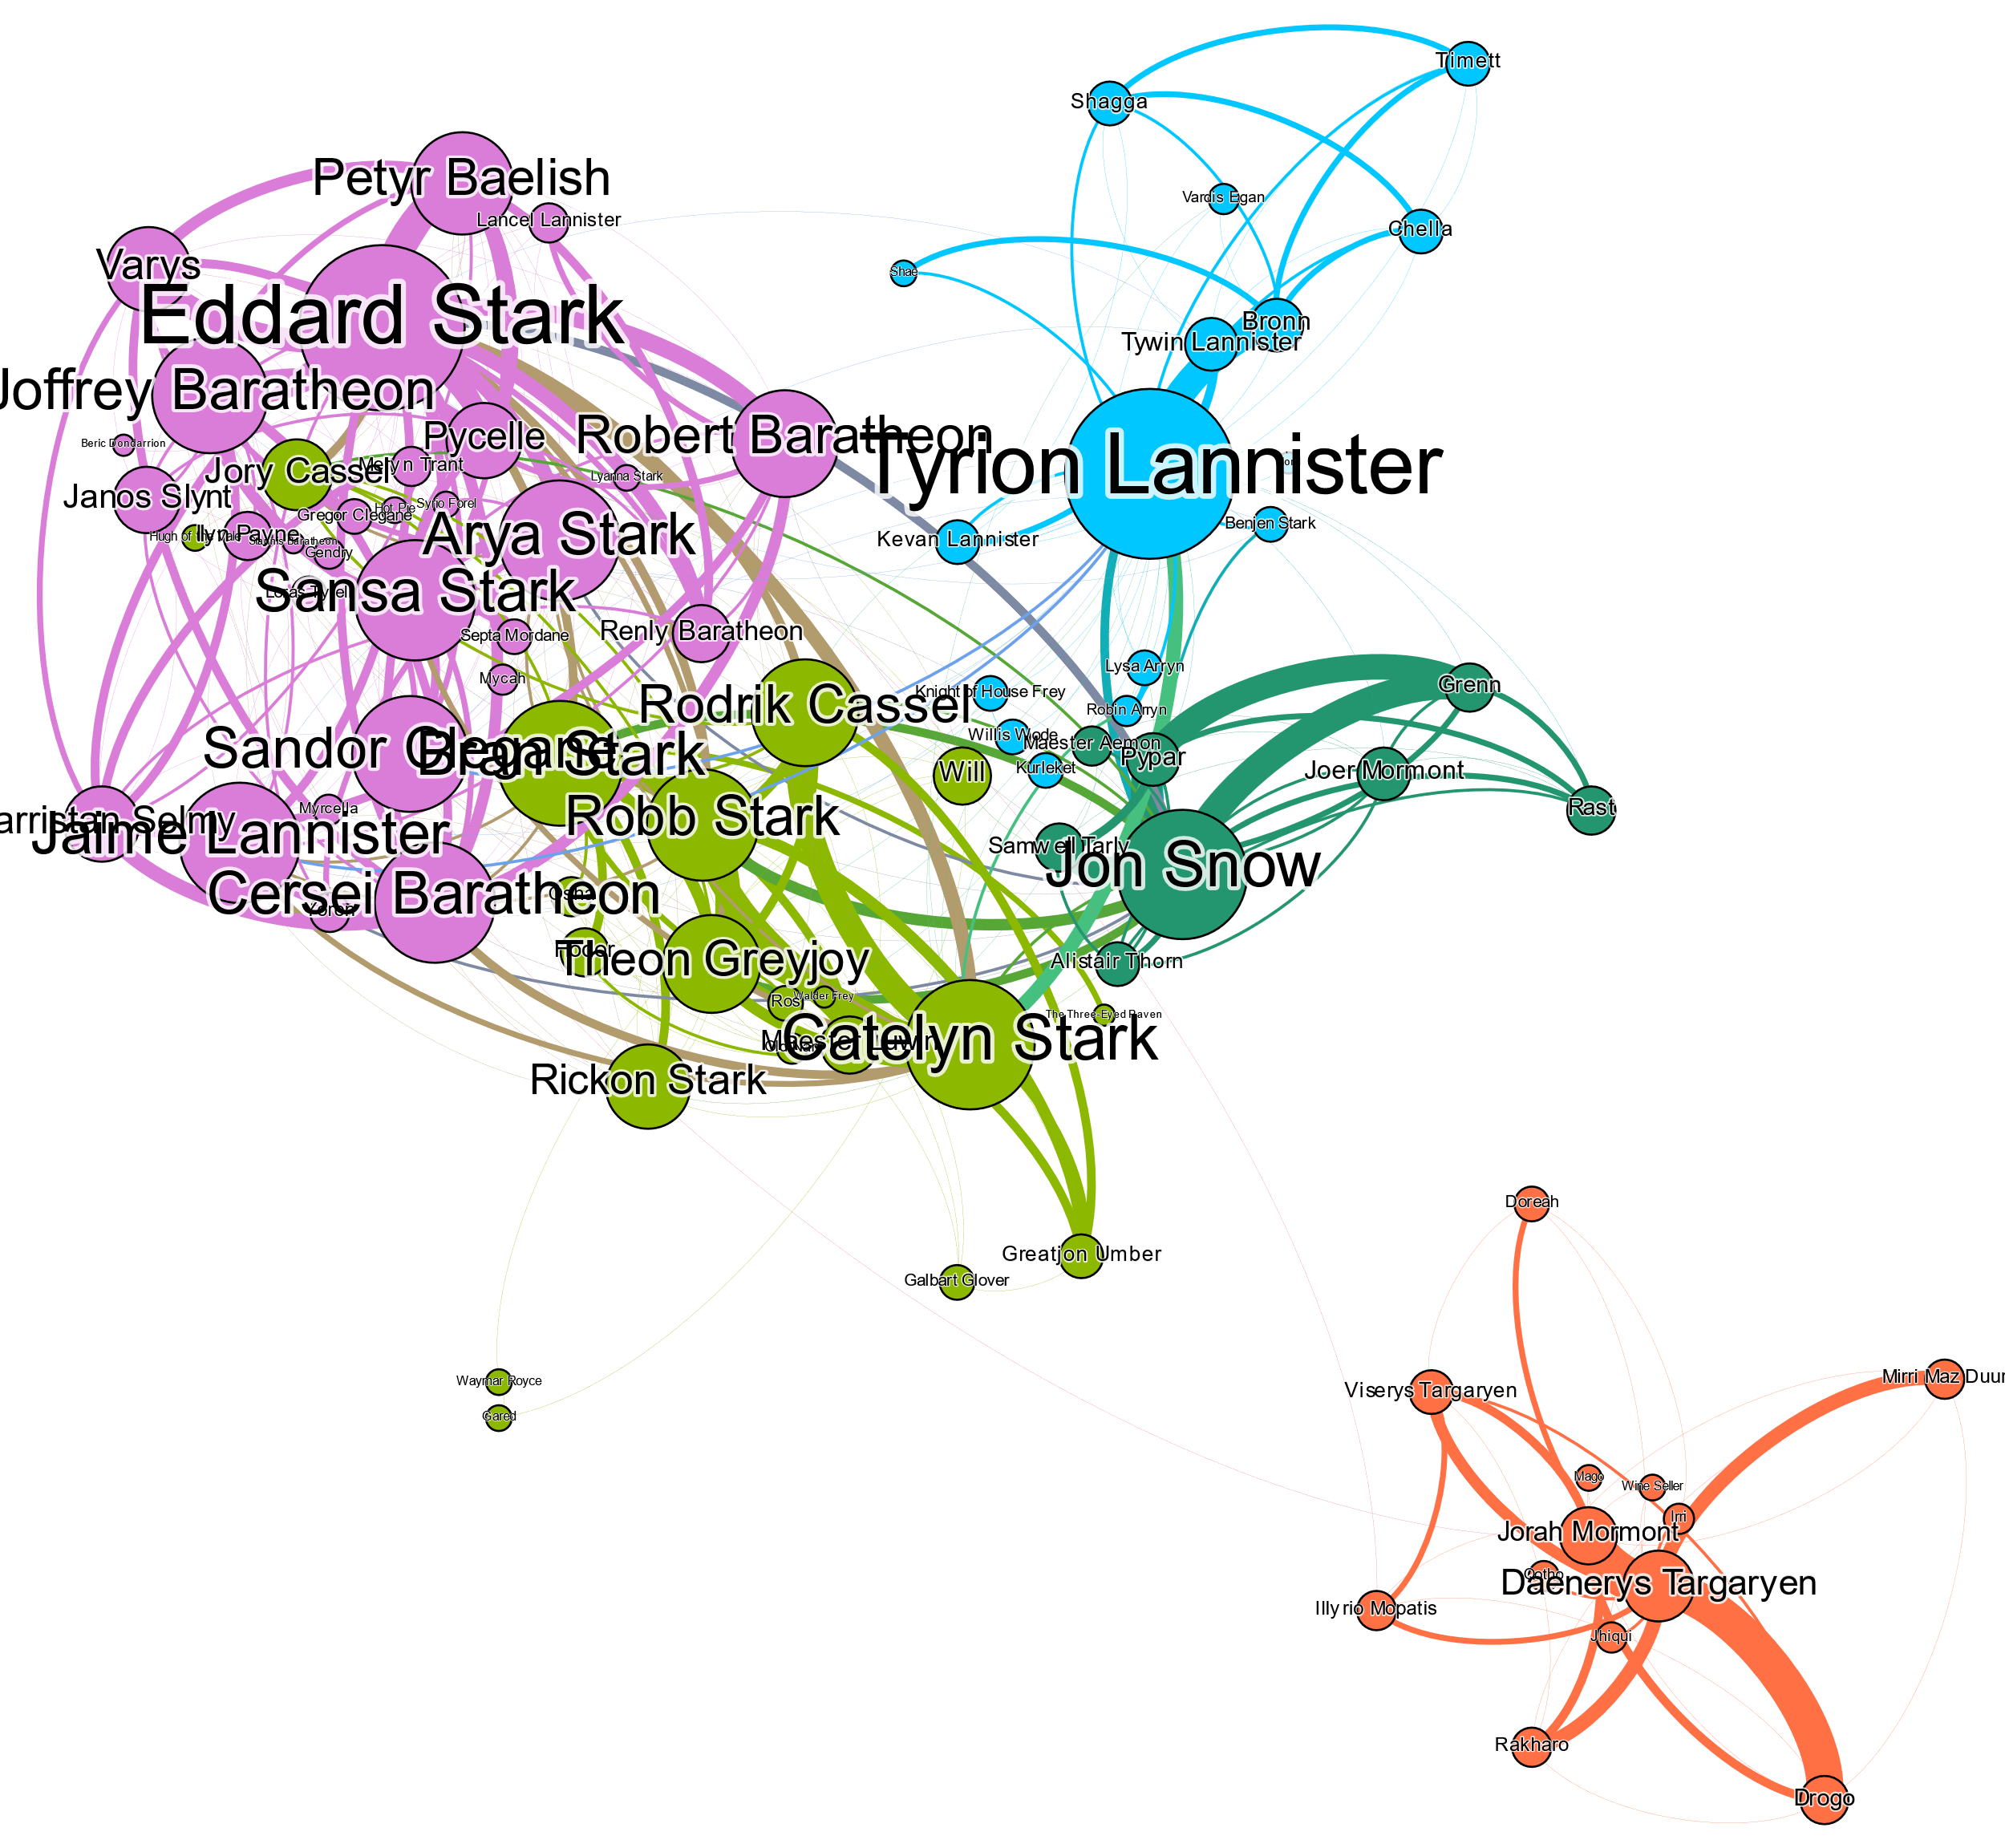
8. Role of Weak and Strong ties
After removal of Weak Ties
“We can observe that by removing Weak nodes, the information spread stops between communities, essentially making them isolated from one another.”

Slide 14
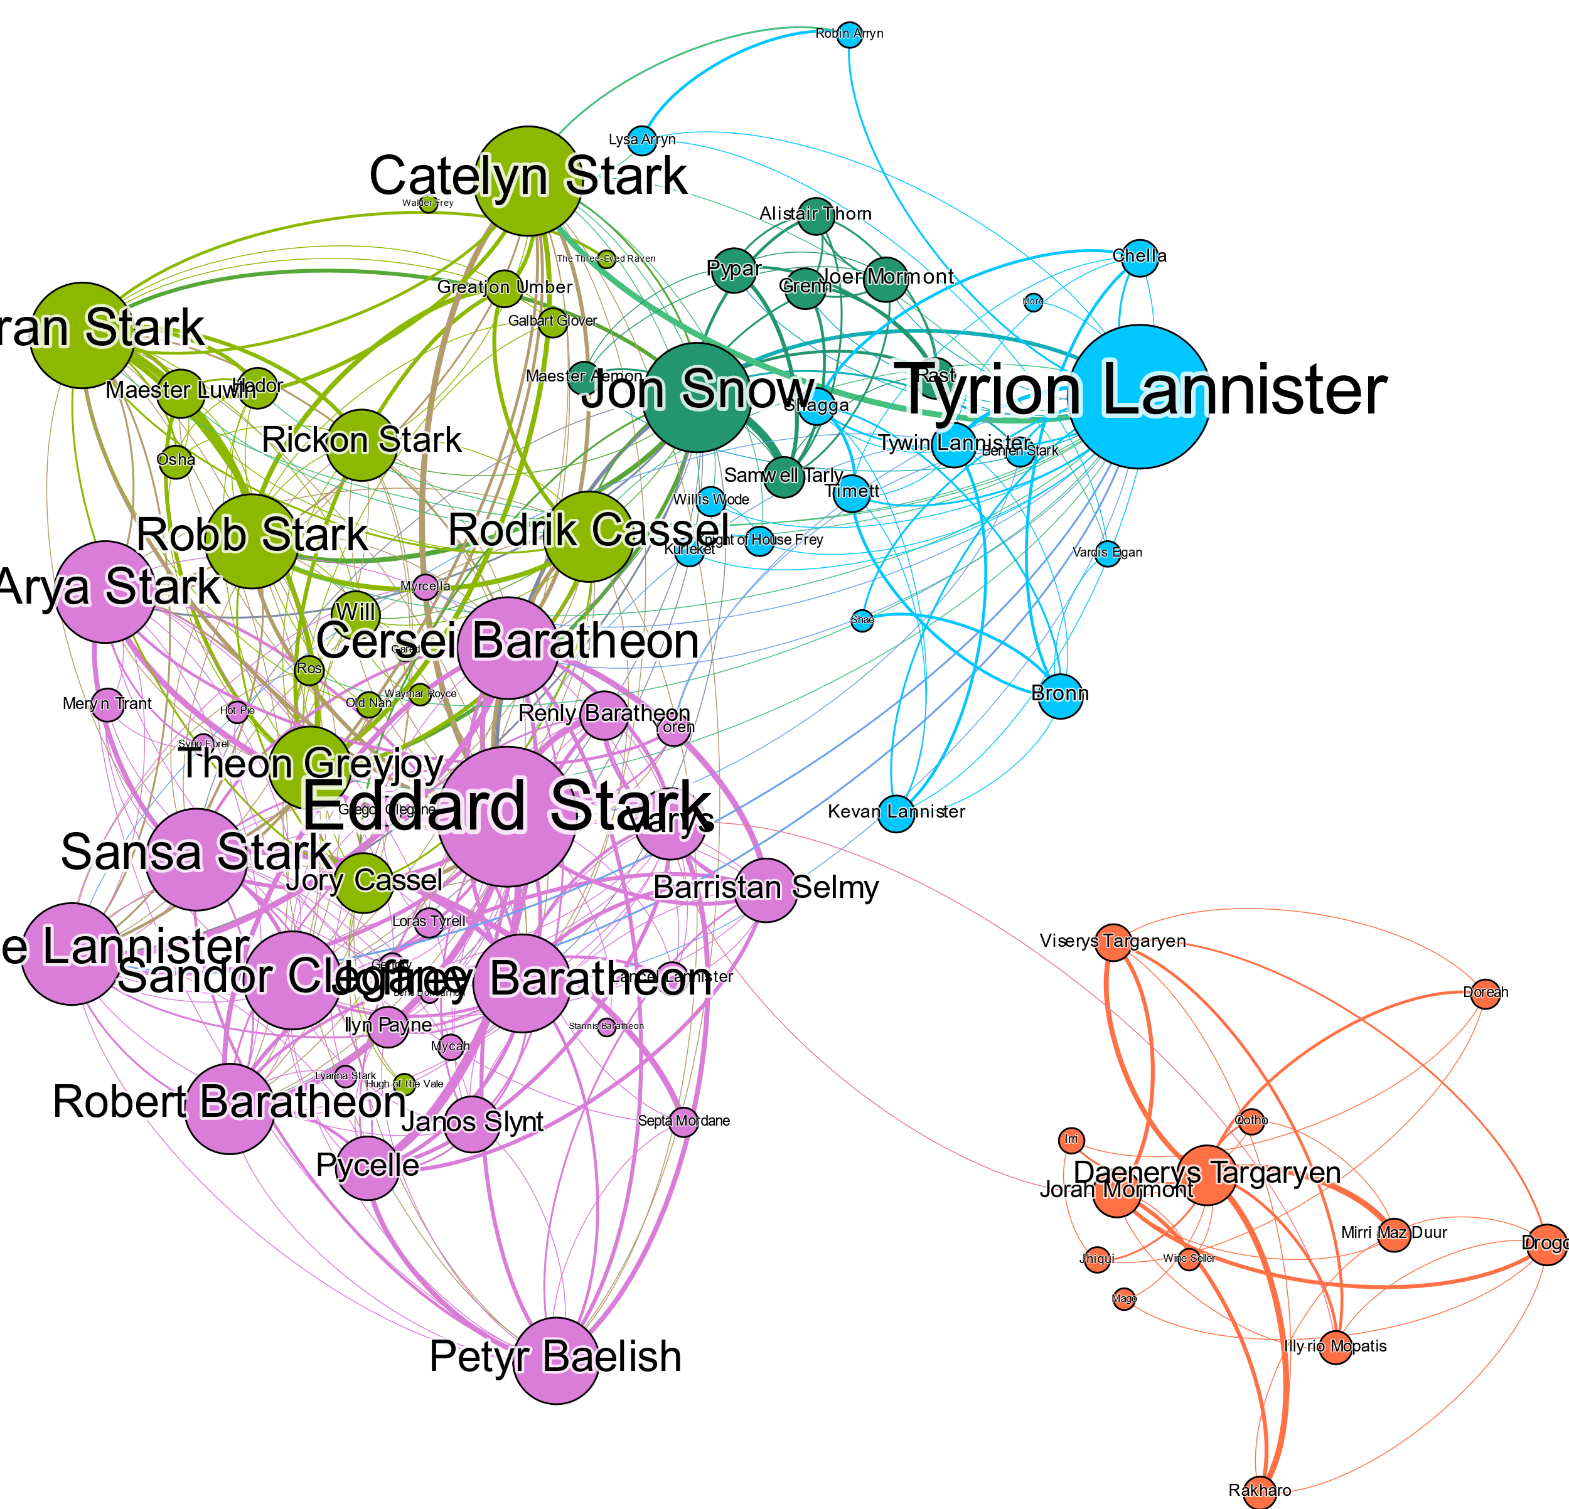
8. Role of Weak and Strong ties
After removal of Strong Ties
“Removal of Strong ties result in breaking down of local communities, this can be observed as how the clusters spread out after the removal.”

Slide 15
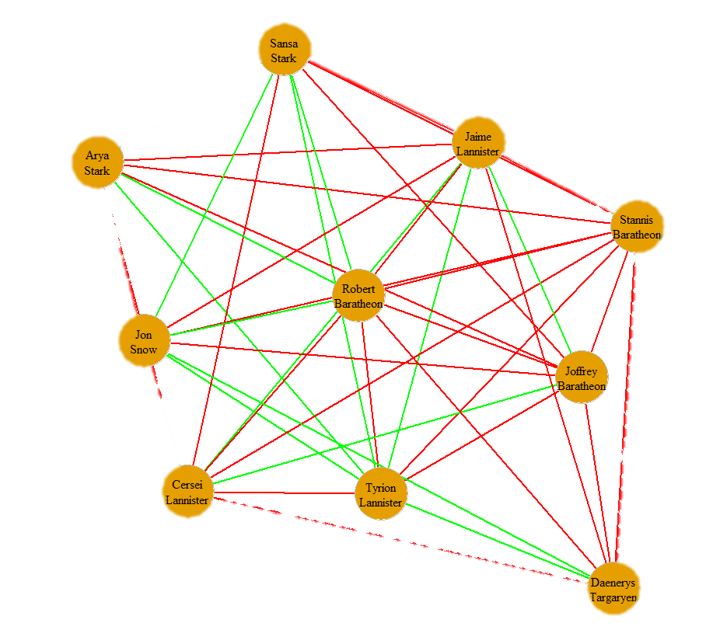
9. Friends and Foes – Structural Balance
The following tables shows the number of triangles formed by the Positive(green) and Negative(red) edges between the 10 most influential players
++ - | + + - | + - - | - - - | Total
9 | 10 | 62 | 24 | 105
Structural Balance Score: 0.67619

Slide 16
10. Longest Plot – Clique Analysis
Book Number | Largest - Clique |  |  |  |  |  |  |  |  |  |  | Characters
Book1 | Robert-Baratheon | Eddard-Stark | Sansa-Stark | Joffrey-Baratheon | Cersei-Lannister | Petyr-Baelish | Catelyn-Stark | Tyrion-Lannister | Jaime-Lannister | Varys |  | 10
Book2 | Joffrey-Baratheon | Cersei-Lannister | Tyrion-Lannister | Sansa-Stark | Jaime-Lannister | Renly-Baratheon | Stannis-Baratheon | Catelyn-Stark | Robb-Stark | Robert-Baratheon |  | 10
Book3 | Joffrey-Baratheon | Tickler | Arya-Stark | Cersei-Lannister | Dunsen | Gregor-Clegane | Ilyn-Payne | Meryn-Trant | Polliver | Rafford | Sandor-Clegane | 11
Book4 | Cersei-Lannister | Jaime-Lannister | Tyrion-Lannister | Tommen-Baratheon | Tywin-Lannister | Mace-Tyrell |  |  |  |  |  | 6
Book5 | Cersei-Lannister | Rafford | Dunsen | Gregor-Clegane | Ilyn-Payne | Meryn-Trant |  |  |  |  |  | 6

Slide 17
11. Future Research
Visualizing “Small World Effect” in the network.
Analyzing “Embeddedness Theory” and “Homophily concept” in ‘A song of Ice and Fire’ network.
Comparing “A song of Ice and Fire” network with “Harry-Potter” network:
How having multiple Protagonists impacts the story

Slide 18
THANK YOU

